Slide 1
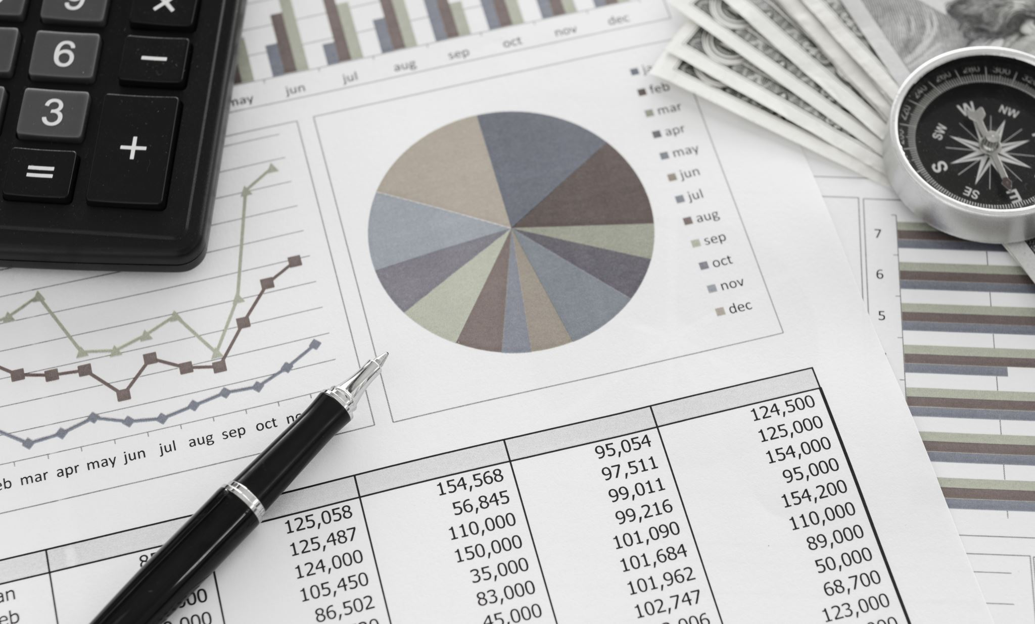
Investment Portfolio
Kanna
Hafila
Jainam
Vaishali

Slide 2

What is Stock Market ?
A marketplace where stocks (pieces of ownership in businesses) are bought and sold.

Slide 3
Project Description
Project Topic: Investment Portfolio
Problem Definitions we are focusing:
Forecast prices of 5 stocks or market indices
What are the optimal weights of the five stocks in your portfolio given a specific return? You need to minimize the risk here.
Appropriate data visualization, identifying and handling outliers and missing values.

Slide 4


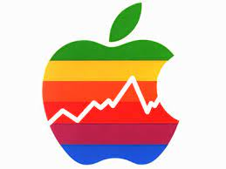


5 Stocks

Slide 5

Data Overview
The variables taken into consideration for helping people choose between stocks are:
Data Collection:
Date: Record of stock market data.
Open: Opening stock price.
Close: Closing stock price.
High: Highest stock price.
Low: Lowest stock price.
Volume: Total stock traded.
Assumption & Uncertainties:
Markets can be unpredictable, and past performance may not guarantee future results
Central bank decisions, inflation, and economic conditions can influence interest rates.
Higher returns are generally associated with higher credit risk.
Technology can disrupt industries, creating opportunities and risks.

Slide 6
Descriptive Analysis
Descriptive analytics involves data preprocessing, exploration, and visualization, unveiling the underlying patterns and trends within the dataset.
Through statistical measures and visualizations, the project offers a clear snapshot of the past, aiding investors in understanding the historical performance of their selected stocks.

Slide 7
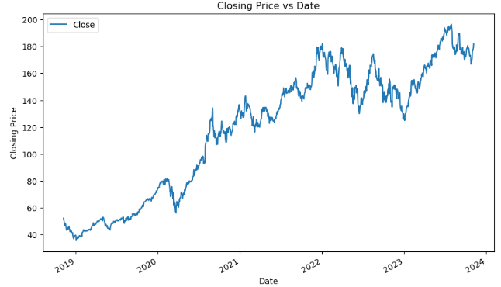
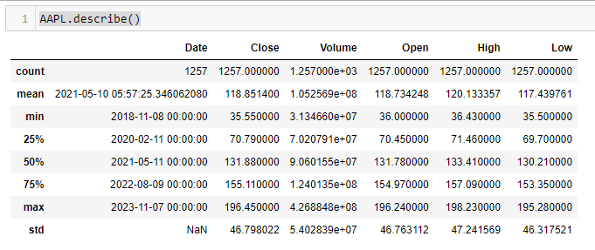
Descriptive Analysis
Understanding the Data
Data Cleaning
Summary Statistics
Data Visualization

Slide 8
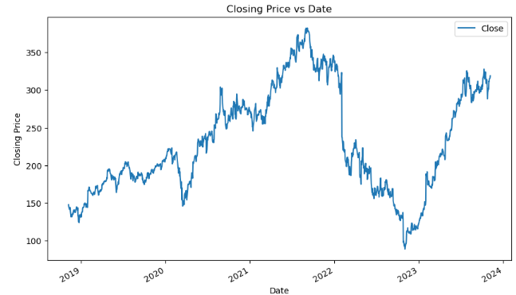
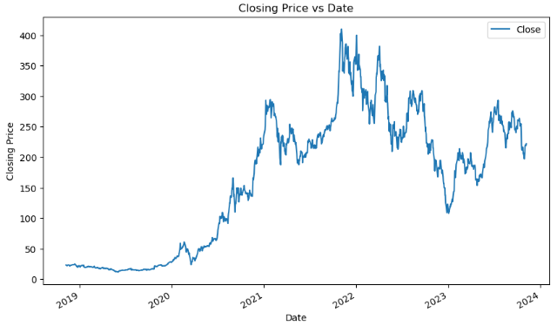
Descriptive Analysis
A historical view of META's closing price is plotted against dates, offering an overview of the stock's performance.
A historical view of TSLA's closing price is plotted against dates, offering an overview of the stock's performance.

Slide 9
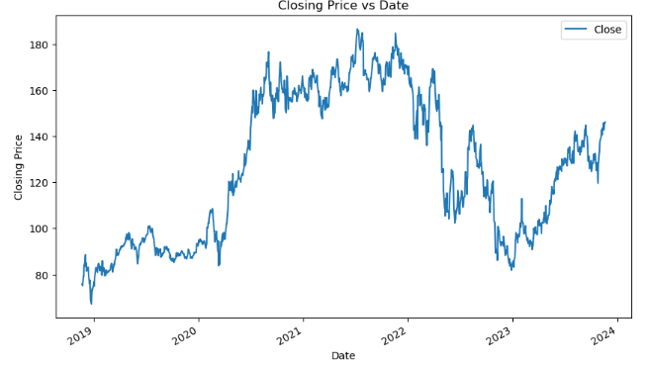
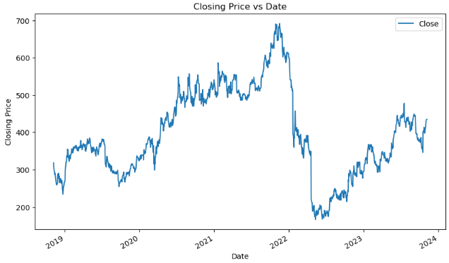
Descriptive Analysis
A historical view of AMZN's closing price is plotted against dates, offering an overview of the stock's performance.
A historical view of NFLX's closing price is plotted against dates, offering an overview of the stock's performance.

Slide 10
Predictive Analytics-Forecast prices of 5 stocks
To forecast the prices of 5 stocks we use time series analysis.
Objective of time series analysis - uncover a pattern and then extrapolate the pattern into the future.
Assumption : the past and this behavior is expected to continue in the future as well.
Time series doesn’t account for sudden changes that may affect the normal behavior of the stock prices.

Slide 11
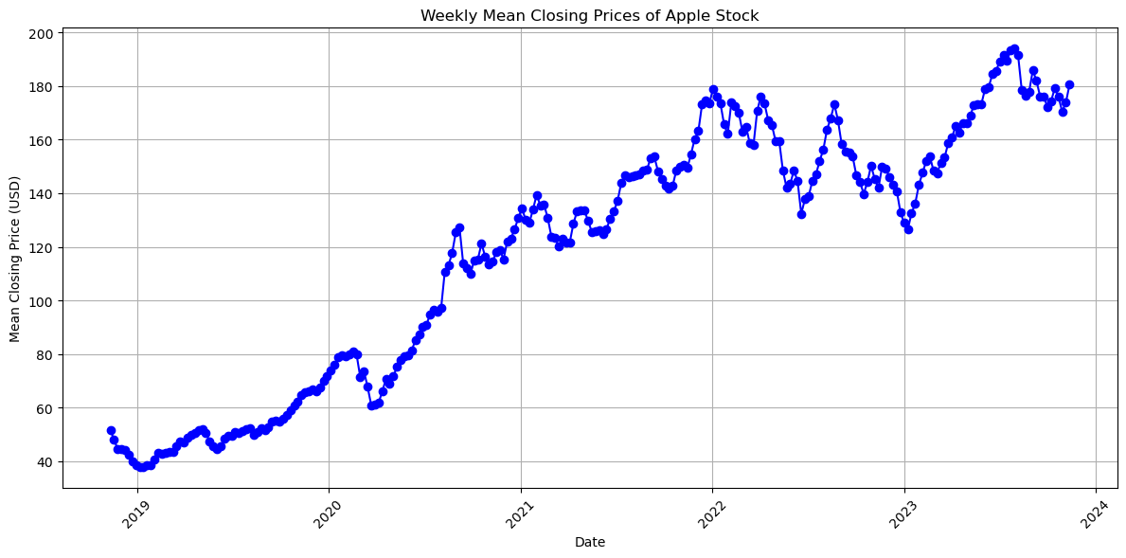
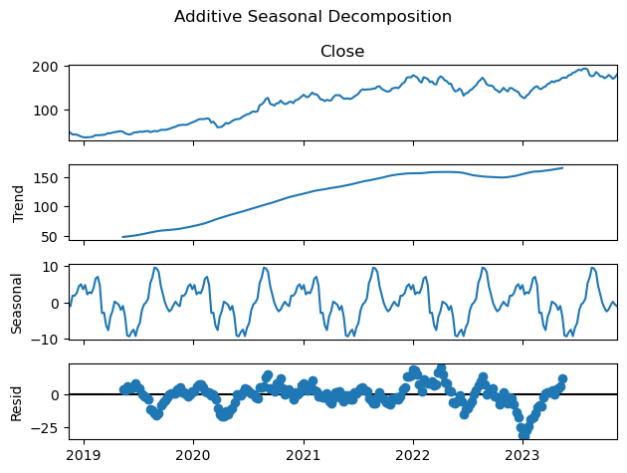
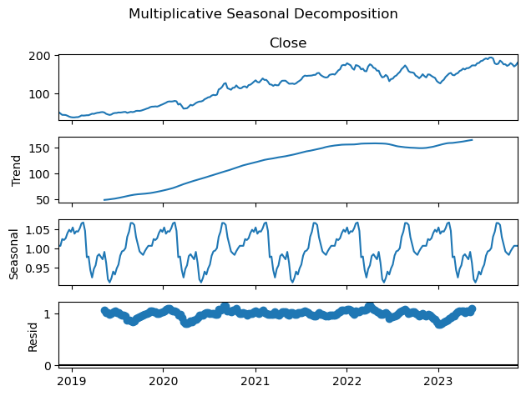
Seasonality
Decomposition
Set Date as the index and we choose the closing price values to make the future predictions

Slide 12
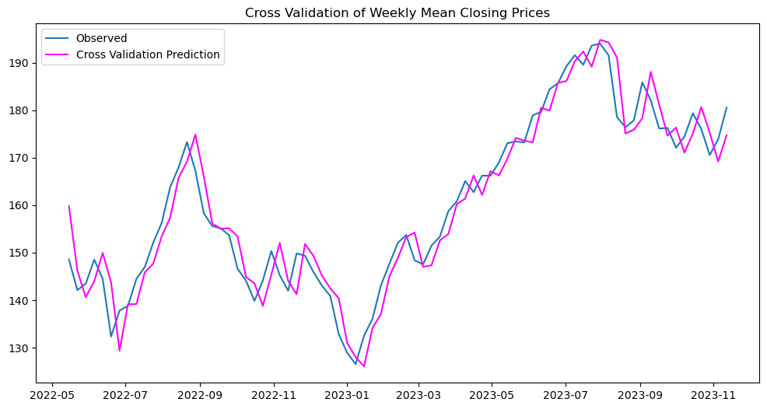
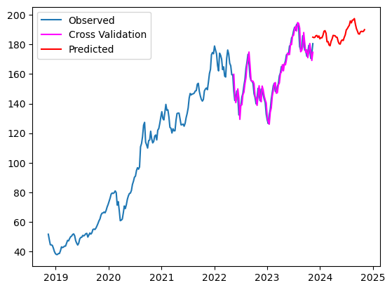
Predictive Analytics
The data is split into training and test sets.
Autoregressive models are trained on the training set.
The models are then used to predict future values on the test set.
The predictions are compared to the actual observations in the test set.
Root Mean Squared Error (RMSE) is calculated as a measure of prediction accuracy.
The results, including observed values, cross-validation predictions, and future predictions, are visualized using plots.
Cross Validation
Prediction for the future
RMSE:4.69

Slide 13
APPLE
RMSE:4.69

Slide 14
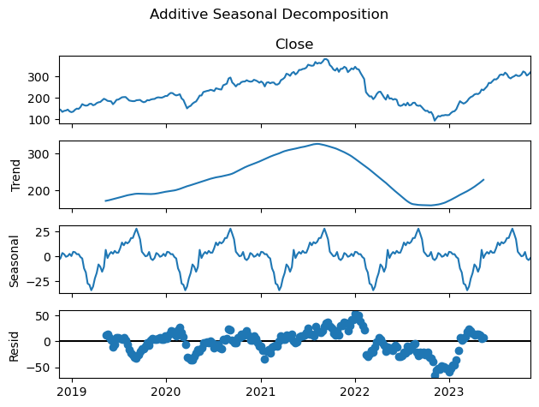
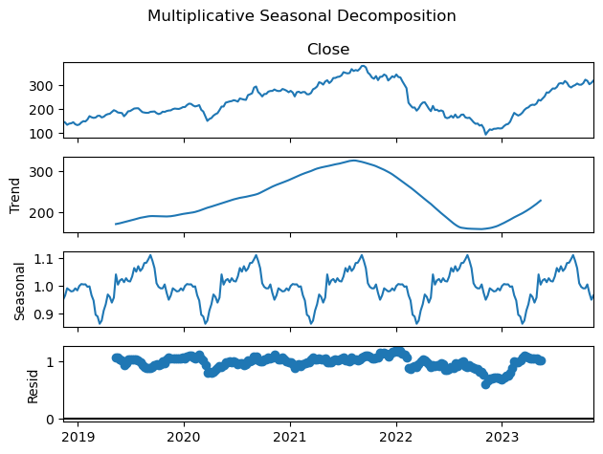
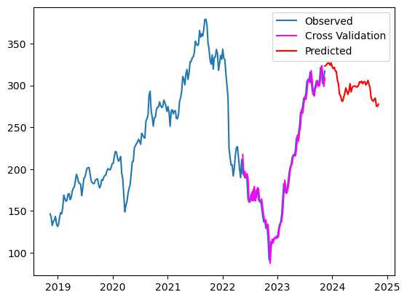
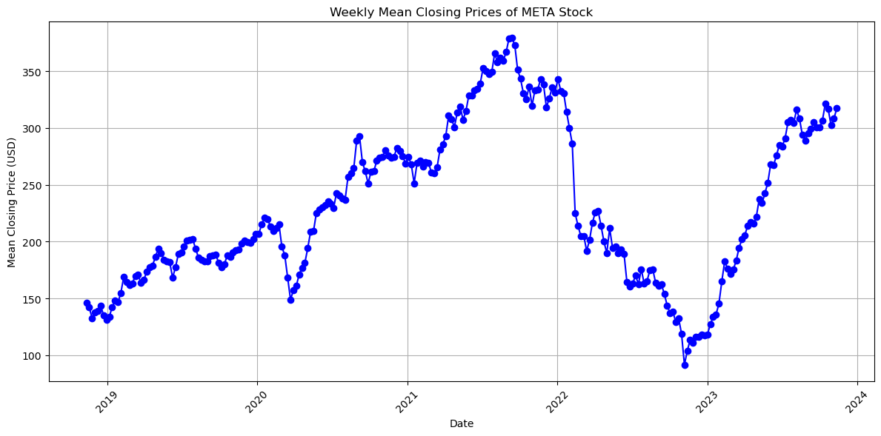
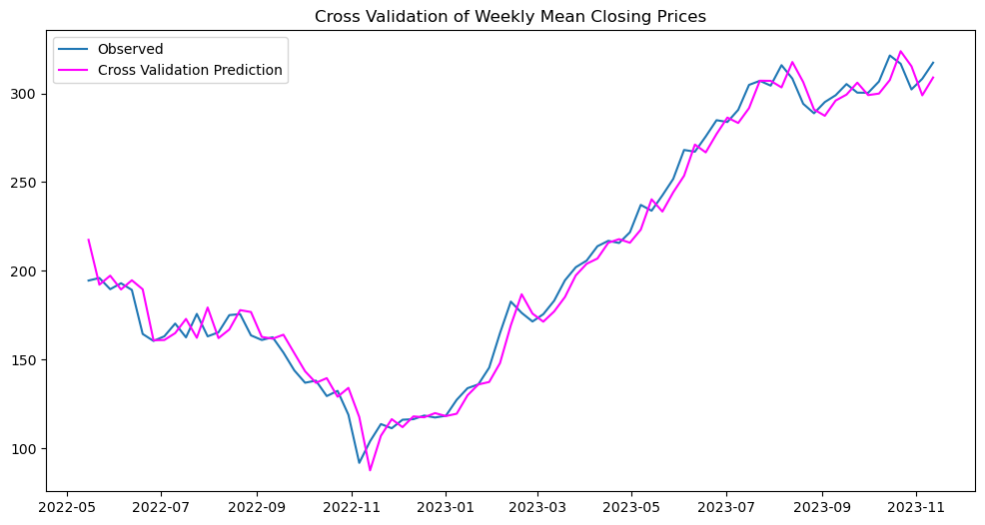
META
RMSE:9.32

Slide 15
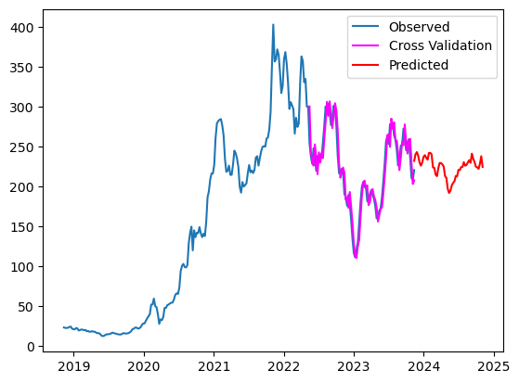
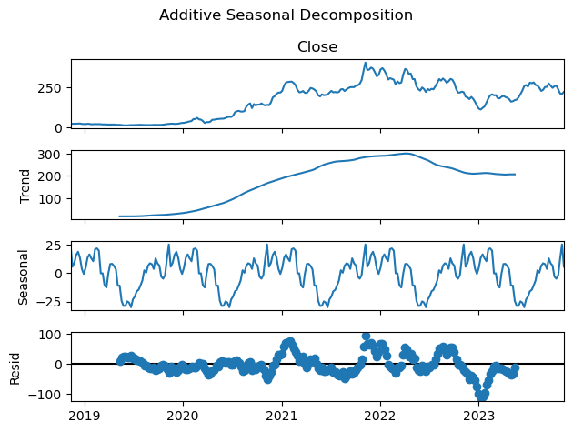
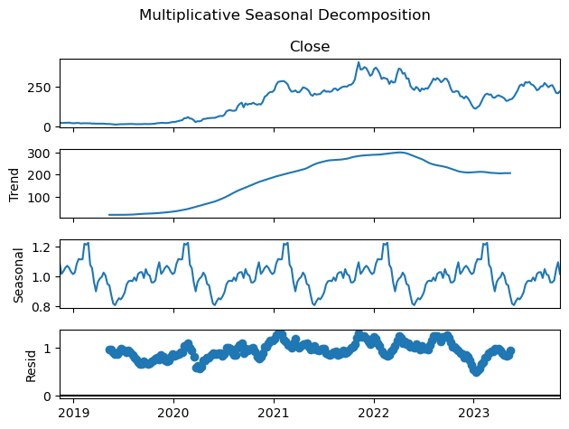
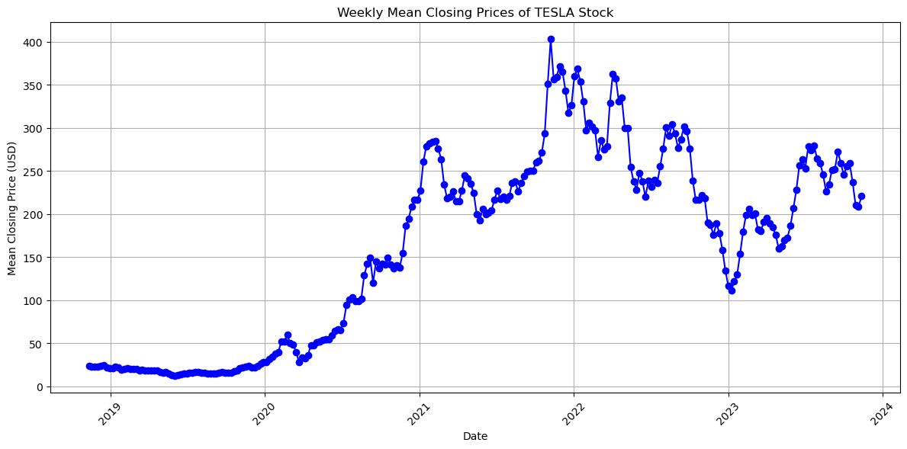
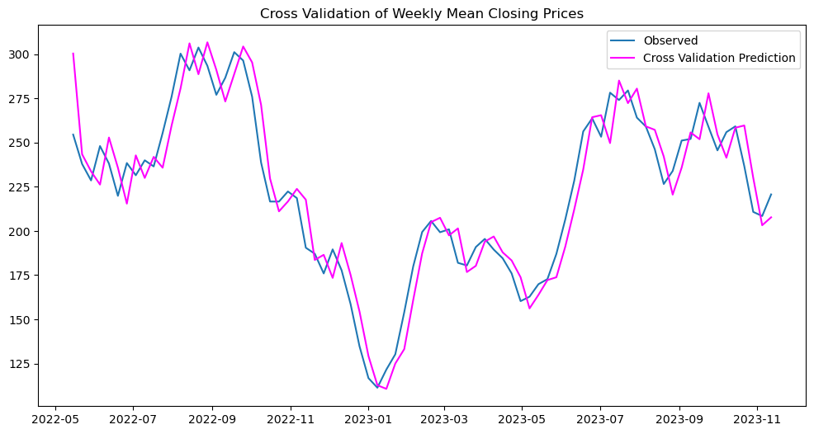
TESLA
RMSE:14.94

Slide 16
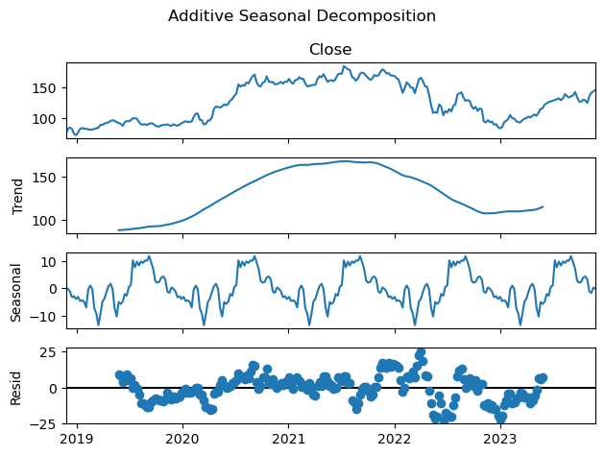
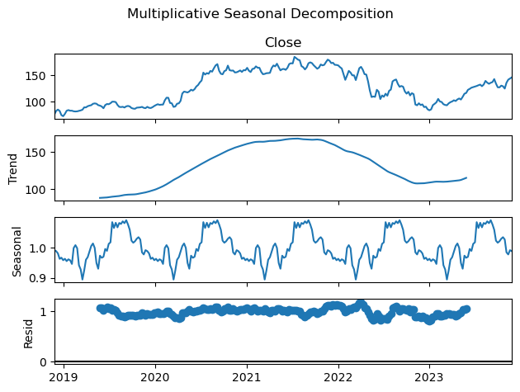
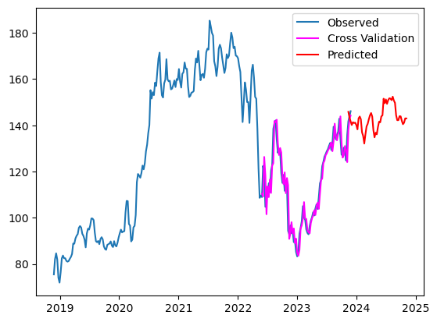
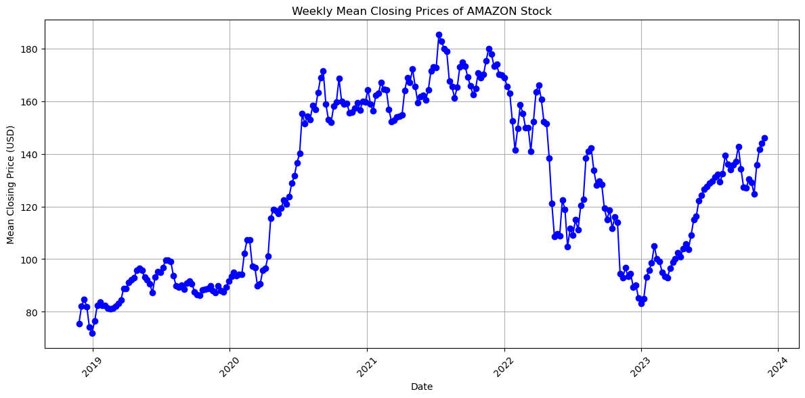
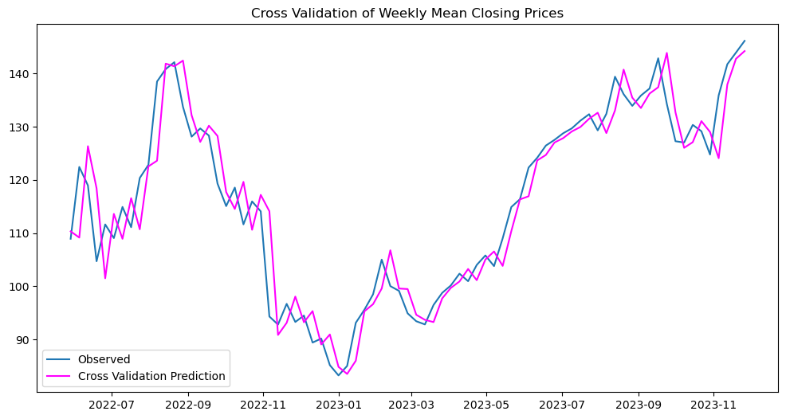
AMAZON
RMSE:5.56

Slide 17
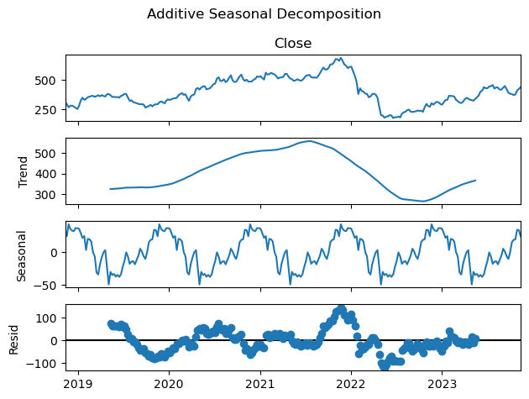
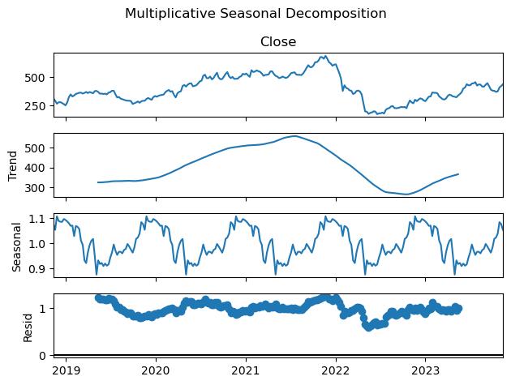
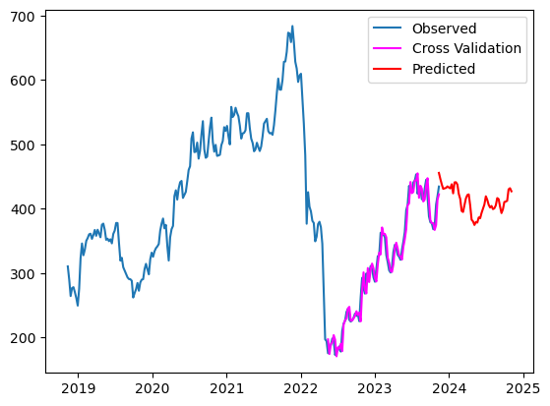
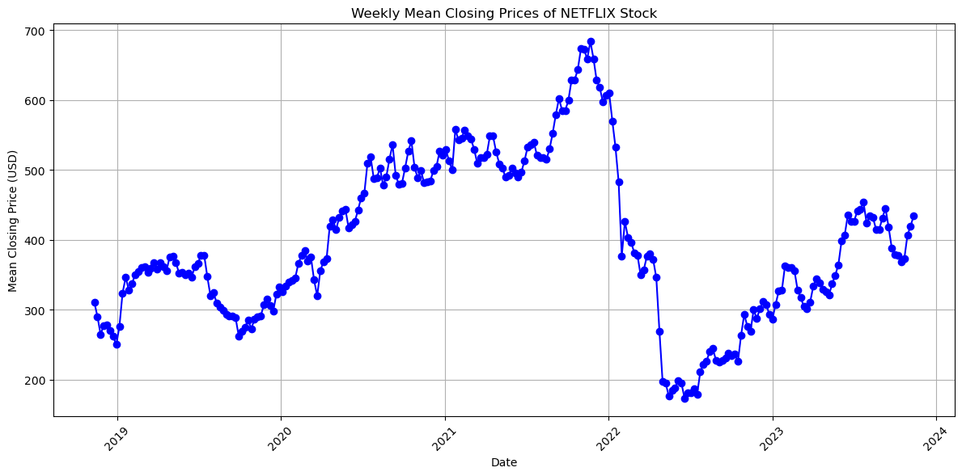
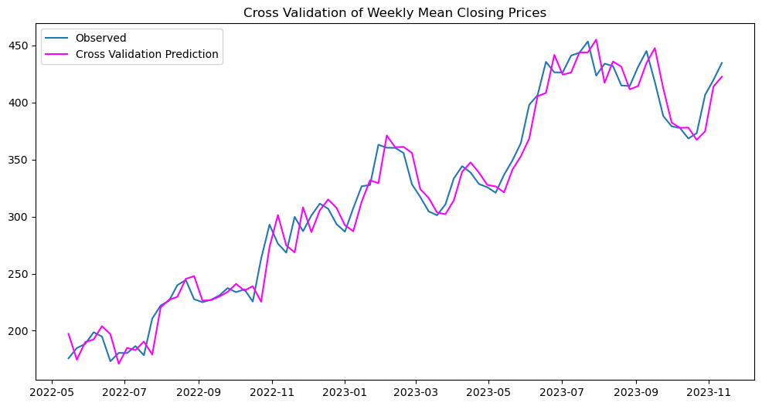
NETFLIX
RMSE:15.35

Slide 18
Prescriptive Analytics
Prescriptive analytics involves suggesting actions based on the insights derived from descriptive and predictive analysis.
This facet aims to guide stakeholders on strategic actions to optimize their investment portfolios.
Problem Statement
What are the optimal weights of the five stocks in your portfolio given a specific return? You need to minimize the risk here. [Optimization]

Slide 19
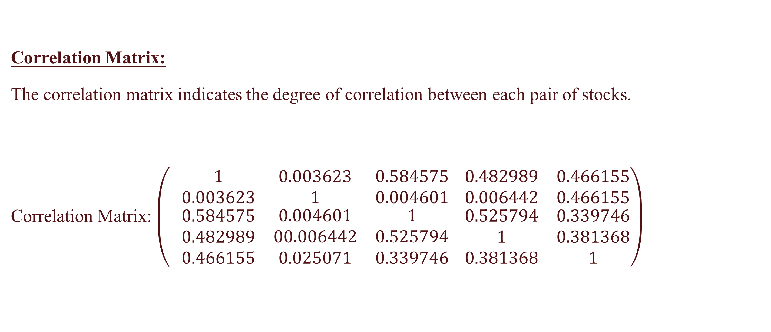
The expected returns and standard deviation of each stock were calculated. The expected returns represent the average daily returns over the historical period, while standard deviation quantifies the level of risk or volatility associated with each stock.
Expected Returns
AAPL: 0.001141
AMZ: -0.000711
META: 0.000056
NFLX: 0.000773
TSLA: 0.002243
Standard Deviation:
AAPL: 0.021094
AMZ: 0.028310
META: 0.027233
NFLX: 0.030067
TSLA: 0.041287
Correlation Matrix:
The correlation matrix indicates the degree of correlation between each pair of stocks.
Correlation Matrix: $\left( \begin{matrix}1 & 0.003623 & 0.584575 \\ 0.003623 & 1 & 0.004601 \\ \begin{matrix}0.584575 \\ 0.482989 \\ 0.466155\end{matrix} & \begin{matrix}0.004601 \\ 00.006442 \\ 0.025071\end{matrix} & \begin{matrix}1 \\ 0.525794 \\ 0.339746\end{matrix}\end{matrix} \begin{matrix}0.482989 & 0.466155 \\ 0.006442 & 0.466155 \\ \begin{matrix}0.525794 \\ 1 \\ 0.381368\end{matrix} & \begin{matrix}0.339746 \\ 0.381368 \\ 1\end{matrix}\end{matrix}\right)$

Slide 20
OBJECTIVE FUNCTION, CONSTRAINTS AND TARGET RETURNS
We assume a target return of 6%.
Weights
Objective Function - Minimize the risk
Equality constraints
Sum of weights = 1
The product of sum of weights and expected returns should be equal to target return
Minimize a function in the Scipy library and SLSQP method

Slide 21
Results
Optimal Weights:
AAPL: 17.98
AMZ: -25.39
META: -3.48
NFLX: 3.45
TSLA: 8.45
In practical portfolio management, negative weights might pose challenges or constraints based on an investor's risk tolerance, regulatory restrictions, or investment strategy.

Slide 22
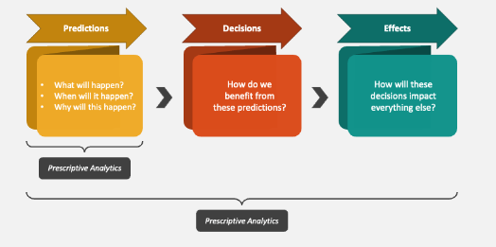

Conclusion
Our project provides a comprehensive analysis of stock data, explores patterns and relationships, and utilizes time series forecasting to predict future closing prices. The results are visualized, allowing for a better understanding of each company's stock performance and potential trends in the coming weeks.

Slide 23
THANK YOU

